Slide 1
Transportation Problem
Transportation Problem: Formulation, solution,
unbalanced Transportation problem.
Optimality test: the stepping stone method and MODI method.
Finding basic feasible solutions – Northwest corner rule, least cost method and Vogel’s approximation method.

Slide 2
Objectives
After Studying this lesson, you should be able to:
Formulation of a Transportation Problem
Determine basic feasible solution using various methods
Understand the MODI, Stepping Stone Methods for cost minimization
Make unbalanced Transportation Problem into
balanced one using appropriate method
Solve Degenerate Problem

Slide 3
Introduction
A special class of linear programming problem is Transportation Problem, where the objective is to minimize the cost of distributing a product from a number of sources (e.g. factories) to a number of destinations (e.g. warehouses) while satisfying both the supply limits and the demand requirement. Because of the special structure of the Transportation Problem the Simplex Method of solving is unsuitable for the Transportation Problem. The model assumes that the distributing cost on a given route is directly proportional to the number of units distributed on that route. Generally, the transportation model can be extended to areas other than the direct transportation of a commodity, including among others, inventory control, employment scheduling, and personnel assignment.

Slide 4
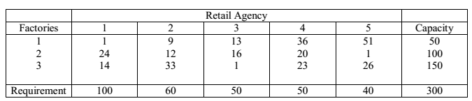
Example
Suppose a manufacturing company owns three factories (sources)and distribute his products to five different retail agencies (destinations). The following table shows the capacities of the three factories, the quantity of products required by the various retail agencies and the cost of shipping one unit of the product from each of the three factories to each of the five retail agencies.
Usually the above table is referred as Transportation Table, which provides the basic information regarding the transportation problem. The quantities inside the table are known as transportation cost per unit of product. The capacity of the factories 1, 2, 3 is 50, 100 and 150 respectively. The requirement of the retail agency 1, 2, 3, 4, 5 is 100,60,50,50, and 40 respectively.

Slide 5
Transportation Algorithm
The steps of the transportation algorithm are exact parallels of the simplex algorithm, they are:
Step 1: Determine a starting basic feasible solution, using any one of the following three methods
1. North West Corner Method
2. Least Cost Method
3. Vogel Approximation Method
Step 2: Determine the optimal solution using the following method
1. MODI (Modified Distribution Method) or UV Method.
The difference among these three methods is the quality of the initial basic feasible solution they produce, in the sense that a better initial solution yields a smaller objective value. Generally the Vogel Approximation Method produces the best initial basic feasible solution, and the North West Corner Method produces the worst, but the North West Corner Method involves least computations.

Slide 6
North West Corner Method:
The method starts at the North West (upper left) corner cell of the tableau (variable x11).
Step -1: Allocate as much as possible to the selected cell, and adjust the associated amounts of capacity (supply) and requirement (demand) by subtracting the allocated amount.
Step -2: Cross out the row (column) with zero supply or demand to indicate that no further assignments can be made in that row (column). If both the row and column becomes zero simultaneously, cross out one of them only, and leave a zero supply or demand in the uncrossed out row (column).
Step -3: If exactly one row (column) is left uncrossed out, then stop. Otherwise, move to the cell to the right if a column has just been crossed or the one below if a row has been crossed out. Go to step -1.

Slide 7
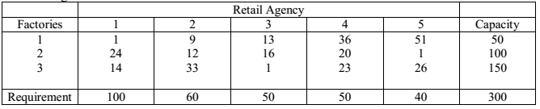
Example

Slide 8
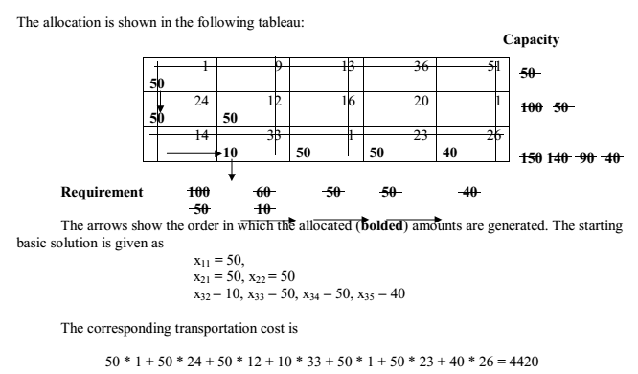
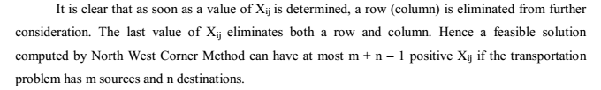

Slide 9
Least Cost Method
The least cost method is also known as matrix minimum method in the sense we look for the row and the column corresponding to which Cij is minimum. This method finds a better initial basic feasible solution by concentrating on the cheapest routes. Instead of starting the allocation with the northwest cell as in the North West Corner Method, we start by allocating as much as possible to the cell with the smallest unit cost. If there are two or more minimum costs then we should select the row and the column corresponding to the lower numbered row. If they appear in the same row we should select the lower numbered column. We then cross out the satisfied row or column, and adjust the amounts of capacity and requirement accordingly. If both a row and a column is satisfied simultaneously, only one is crossed out. Next, we look for the uncrossed-out cell with the smallest unit cost and repeat the process until we are left at the end with exactly one uncrossed-out row or column.

Slide 10
Example

Slide 11
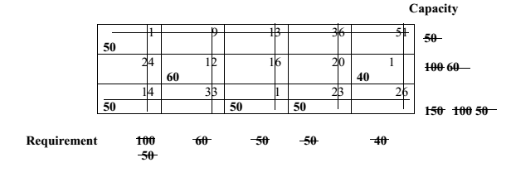
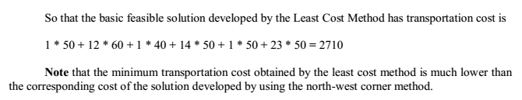

Slide 12
Vogel Approximation Method (VAM):
VAM is an improved version of the least cost method that generally produces better solutions. The steps involved in this method are:
Step 1: For each row (column) with strictly positive capacity (requirement), determine a penalty by subtracting the smallest unit cost element in the row (column) from the next smallest unit cost element in the same row (column).
Step 2: Identify the row or column with the largest penalty among all the rows and columns. If the penalties corresponding to two or more rows or columns are equal we select the topmost row and the extreme left column.
Step 3: We select Xij as a basic variable if Cij is the minimum cost in the row or column with largest penalty. We choose the numerical value of Xij as high as possible subject to the row and the column constraints. Depending upon whether ai or bj is the smaller of the two ith row or jth column is crossed out.
Step 4: The Step 2 is now performed on the uncrossed-out rows and columns until all the basic variables have been satisfied.

Slide 13
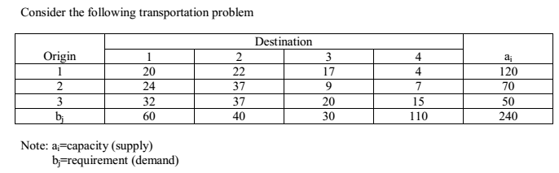
Example
Solution:

Slide 14
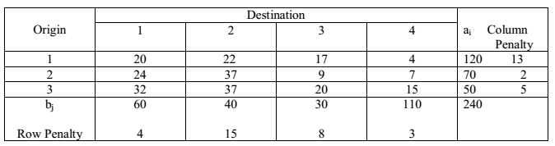
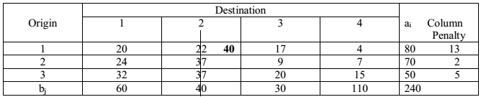


Slide 15
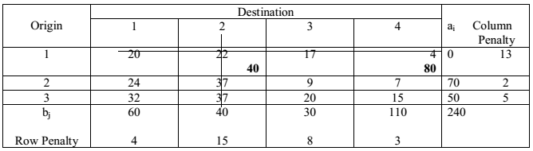
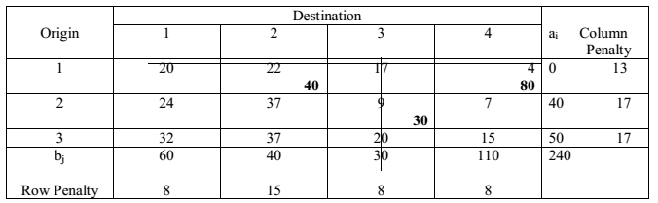

Slide 16
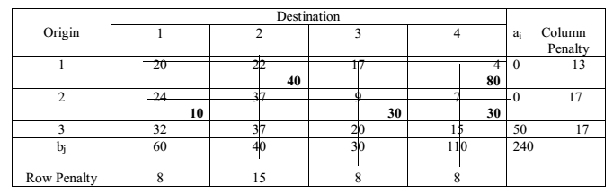
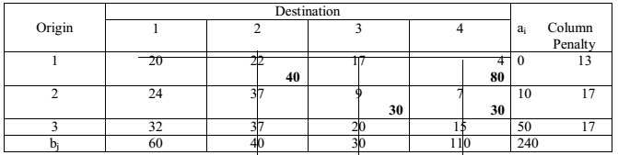


Slide 17
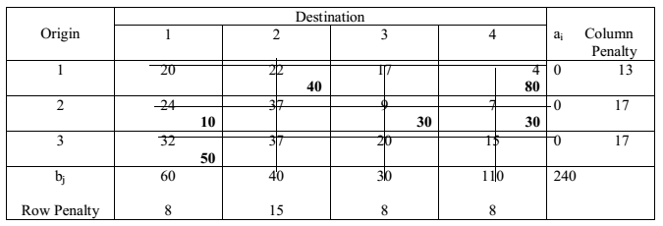


Slide 18
Reference:
http://www.pondiuni.edu.in/storage/dde/downloads/mbaii_qt.pdf
Transportation problem||vogel's approximation[VAM]|Northwest corner||Least cost||
https://www.youtube.com/watch?v=ItOuvM2KmD4

Slide 19
Quiz
https://tinyurl.com/transprob1
https://tinyurl.com/transprob2

